Slide 1

Count of Smaller Numbers After Self
By :
HEMANTH K
(192210229)
CSA0695- Design and Analysis of Algorithms for Open Addressing
Faculty :
Dr R Dhanalakshmi

Slide 2
Problem Statement
Problem
Input and Output
Explanation
Count of Smaller Numbers After Self Given an integer array nums, return an integer array counts where counts[i] is the number of smaller elements to the right of nums[i].
Input:
nums = [5,2,6,1]
Output:
[2,1,1,0]
To the right of 5 there are 2 smaller elements (2 and 1).
To the right of 2 there is only 1 smaller element (1).
To the right of 6 there is 1 smaller element (1).
To the right of 1 there is 0 smaller element.

Slide 3
Abstract
The "Count of Smaller Numbers After Self" problem is a fundamental algorithmic challenge that requires determining, for each element in an integer array, the number of smaller elements to its right.
This project presents an efficient c-based solution utilizing advanced data structures such as Binary Indexed Trees (Fenwick Trees).
The primary objective is to achieve optimal time complexity while ensuring accuracy in count calculations.
Results demonstrate the effectiveness of the chosen methods in handling large datasets with improved performance metrics.
The conclusion highlights the project's success in addressing the problem efficiently and outlines future enhancements for broader applicability

Slide 4
Introduction
The challenge in solving this problem lies in efficiency. A straightforward brute-force solution would involve comparing each element with every other element to its right, leading to a time complexity of O(n²).
This approach, while simple, becomes impractical for large arrays. As a result, more advanced methods and data structures are necessary to reduce the time complexity and make the solution scalable.
The goal is to implement a solution that is both time-efficient and adaptable to larger datasets.

Slide 5
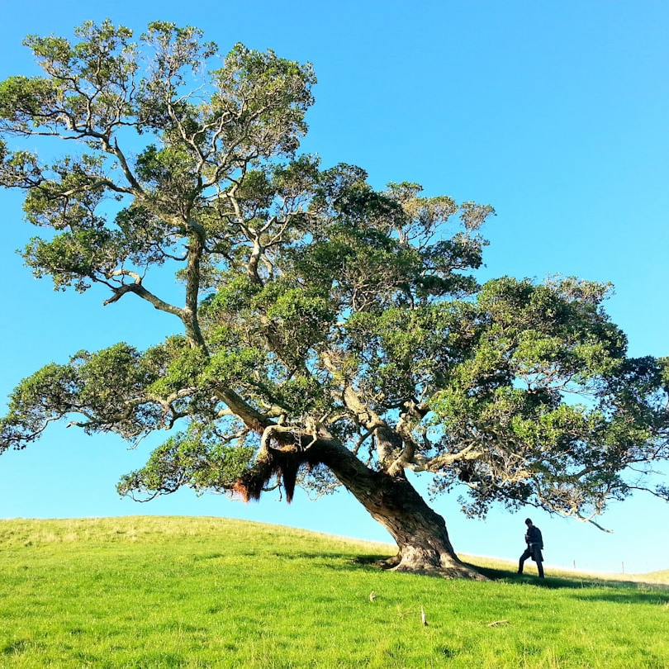
Fenwick Tree Overview
What is a Fenwick Tree?
The Fenwick Tree, or Binary Indexed Tree, is an advanced data structure that provides efficient methods to perform cumulative frequency tables. It allows for quick updates and queries.
Purpose in Counting
It is particularly useful for problems like counting smaller numbers after a given number in lists. The Fenwick Tree enables these operations to be done in logarithmic time.
Structure and Operation
Fenwick Trees maintain a compact binary structure. They use arrays to store cumulative frequency, allowing easy addition and subtraction of frequency values.

Slide 6
Algorithm Steps
Step | Action | Complexity
1 | Initialize Fenwick Tree Array | O(n)
2 | Iterate through Input Array | O(n)
3 | Update Fenwick Tree | O(log n)
4 | Query for Count | O(log n)

Slide 7
Time Complexity Analysis
50%
25%
25%
Initialization
Update Operations
Query Operations
This includes the time taken to create the Fenwick Tree data structure. Typically O(n).
This is the logarithmic time taken to update tree values. On average, O(log n) per update.
The time taken to process a query using the tree structure, resulting in O(log n).

Slide 8

Use Cases
Data Analysis
Fenwick Trees are widely used in data analysis, especially for problems involving frequency counts and cumulative sums. This finds applications in data mining.
Competitive Programming
A common data structure in competitive programming, Fenwick Trees enable efficient query processing and are frequently used for range sum queries.
Real-Time Systems
In real-time systems, the ability to quickly count or respond to changes is crucial. Fenwick Trees facilitate effective solutions for dynamic arrays.

Slide 9

Conclusion & Future Work
Summary of Findings
Potential Improvements
Fenwick Trees present a powerful method for counting smaller numbers. Their ability to handle dynamic queries efficiently makes them a critical tool.
Future research could focus on optimizing space complexity and enhancing updates further, such as combining with other data structures.
Applications Beyond Counting
Exploring more use cases beyond counting could unveil further applications in areas such as algorithms for searching and sorting data.

